Slide 1





We understand your world
Customer Delight
Re-Engineering Debit Card & PIN Issuance Process
Ratan Kesh
Sr. VP and Head – Quality Initiatives Group

Slide 2
HDFC Bank – An Overview
Loan Products:
Auto/ 2-Wheeler Loans
Business Banking
Personal Loans
Credit Cards
Commercial Vehicles Finance
Construction Equipment Finance
Mortgages
Loans against Securities
Tractor and Agri loans
Education Loans
Gold Loans
Deposit Products:
Savings & Current Accounts
Fixed / Recurring Deposits
Corporate Salary Accounts
Other Products / Services:
Depository Accounts
Mutual Fund Sales
Private Banking
Insurance Sales (Life, General)
NRI Services
Bill Payment Services
POS Terminals
Debit Cards
Gold Sales
Foreign Exchange Services
Retail
Banking
Wholesale
Banking
Commercial Banking:
Working Capital
Term Loans
Bill Collection
Forex & Derivatives
Wholesale Deposits
Letters of Credit/Guarantees
Transactional Banking:
Cash Management
Custodial Services
Clearing Bank Services
Correspondent Banking
Tax Collections
Banker to Public Issues
Key Segments:
Large Corporate
Emerging Corporates
Financial Institutions
Government / PSUs
Supply Chain (Suppliers and dealers)
Agriculture
Commodities
Treasury
Other Functions:
Asset Liability Management
Statutory Reserve Management
Products:
Foreign Exchange
Debt Securities
Derivatives
Equities
Complete Suite of Products to Meet Diverse Customer Needs

Slide 3
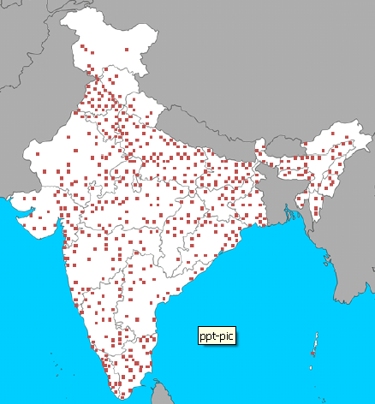
Strong National Network
All branches linked online, real time
“Anytime, Anywhere, Anyhow” banking
75% branches outside the top 9 cities
Customer base of 26 million

Slide 4
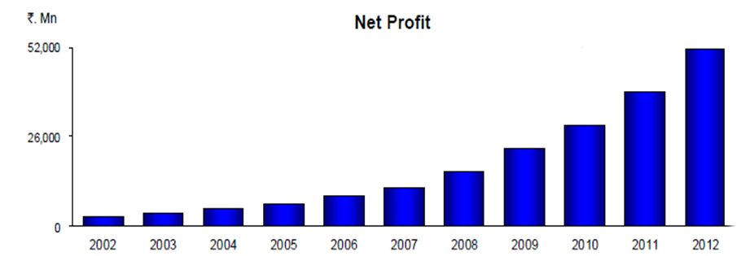
Consistent Financial Performance
CAGR* 33%
Indian GAAP figures. Fiscal year ended 31st March
* 10 year Compounded Annual Growth Rate

Slide 5

External Recognition
Company of the Year - ET Corporate Awards 2012
Best Bank in Customer Relationship Initiative – IBA 2012, 2011
Best in Customer and Brand Loyalty - Loyalty Summit award 2012
Skoch Foundation Financial Inclusion Award 2011
Celent Best Customer Initiatives 2011
Best Bank In India by Business World, CNBC TV18, Euromoney
Best Retail Bank in India by Asian Banker - 2011
The strongest Bank in Asia 2010 by FE
Best practices in IT Governance and IT Security
The strongest bank in Asia Pacific by Asian Bankers
ET – Most Trusted Brand

Slide 6
Debit Card?

Slide 7




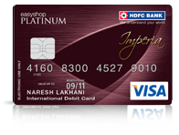


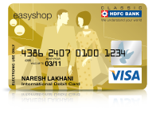



What does a Debit Card mean to us
7

Slide 8
Debit Cards – Strategic Significance
4th Largest Debit Card Issuer
15.3 million cards as of July ‘12
No. 1 in Debit Card Portfolio spends in FY 11-12
Rs.91.5 billion portfolio spends through 61.3 million transactions
3 lakh+ new Debit Cards per month
47% cardholders in Non-Tier-I locations
Offers more than 25 variants catering to different needs

Slide 9

Debit Card – Empowering rural India
Financial Inclusion Objective
Providing Sustainable Livelihood to
7 Million Rural Families in next 5 years.

Slide 10
Define

Slide 11
Why This Project?
Sr. No. | Top Complaints (Apr 11 – Nov 11) | % of Total complaints received
1 | Delay/Non Delivery of Debit card/PIN | 13%
2 | Account activation related | 11%
3 | Cheque deposited at branch not credited/delayed | 5%
4 | Address Change Request Given At Branch Not Done | 5%
5 | Delay In Closure Of Account | 5%
6 | AQB Charges / Reversal Related | 4%
7 | Delay/ non Receipt of Welcome Kit | 4%
8 | Alerts sent to non-account holder | 4%
9 | Others | 50%

Slide 12

Voice of Customer
My registered address is in Pune. However, I am now in Shrirampur. Can I immediately get Debit Card from nearby Branch??
I am Happy And Satisfied For Account But I got Debit Card too late
I got the card, but PIN was received too late. Why cant it be sent together??
I don’t have time to visit your Branch. Why cant I place request for Debit Card over phone?
I lost my card. Call center agent blocked my card but he wont take request for new card without password/TIN?
Your ATM swallowed my debit card and call center says it is deactivated and I haven't got new card!!

Slide 13
Debit Card Experience influencing Advocacy

Slide 14
Measure & Analyse

Slide 15

Key Metrics
TAT
Baseline: 10-12 days
Target: 5-7 days
Complaints
Baseline: 4.2%
Target(Mar 12): 2%
Target (Jul 12): <1%
- Customer Satisfaction
- Revenue
- Cost
4.0%
4.1%
4.5%
5%
3.8%
4%
4.0%
4.1%
4.5%
5%
3.8%
4%
FTNR
Baseline: 10.1%
Target (Mar 12): 4%
Target (Jul 12): <1%
Complaints to Cards Ratio
Total Cards Complaints Received
------------------------------------------------
Total Cards Issued

Slide 16




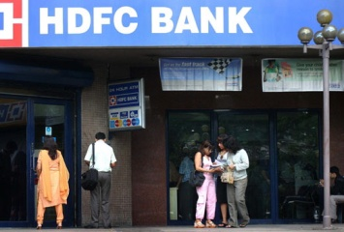

As-is scenario & Identifying Gaps
My card has expired. Need a new one
Need to upgrade my card
Customer unable to place request for new card without a TIN. Routed to branch
I have not received my Debit Card / Pin
Lost my card. Need to block it & re-issue
Customer had to place re-issuance request on same day or else routed to branch
Staff not aware of TAT to be committed to customer
YES
Part 1 - PLACING THE REQUEST
Customer asked for Telephone Identification Number(TIN)
No
TIN available with customer?
Yes
Customer request taken & forwarded to Ops.
A1

Slide 17

As-is scenario & Identifying Gaps
A1
Re-work at branch & Ops due to FTNR
Request received and checked by Ops
Delay in processing due to FTNR
Is application/ Documents complete?
No
Yes
Part 2 - PROCESSING THE REQUEST
Request is processed and forwarded for printing
Cured by branch & re-sent to Ops
B1

Slide 18
As-is scenario & Identifying Gaps
B1
Debit Card / Pin printed
Customer has no active card in case new card is not delivered within 10 days, leads to card swallow by ATM
Dispatched to customer address
Not delivered due to various reasons including courier vendor performance.
Old Card is deactivated on 10th day after new card is dispatched without delivery confirmation
SMS reaches customer before returned card is received at Branch, leads to customer unnecessary visiting Branch
Part 3 – PRINTING & DISPATCH
Courier delivered?
No
Yes
Debit Card / Pin returned to bank.
Customer acknowledgement received.

Slide 19

As-is Scenario (Summary of gaps identified)
TIN Available ?
Reissuance Card Today?
Phone Banking
YES
NO
Diverted to Branch due to No TIN / Issuance on another day.
Staff no aware of TAT
Branch
Form Verification
Dispatch to CPU
Staff not aware of TAT
Rework at Branch / CPU due to FTNR
CPU
Form Verification: FTNR
Dispatch thru Courier
Block existing card
Delay due to FTNR
Customer not able to use card as new card is yet to received
Courier
TAT Issues
Delivery Issues
Card/Pin sent separately
TAT Based on Branch Classification
SLA not defined
Card received, PIN Not received
SMS not sent on time

Slide 20
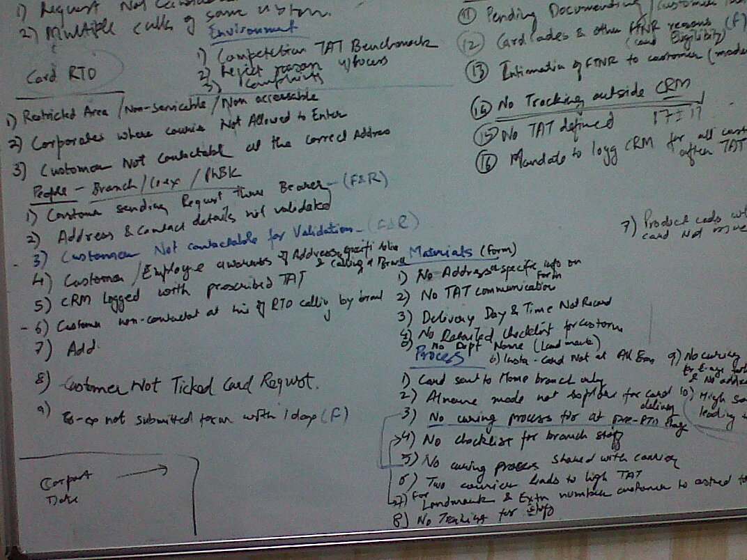
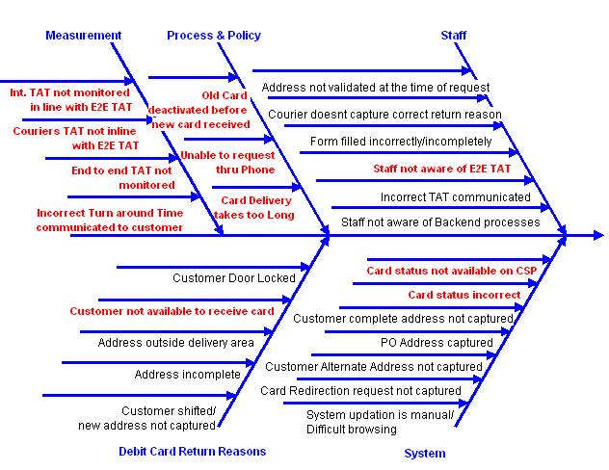
Analyze – Root Cause Analysis
Complaint
High TAT
High FTNR

Slide 21
Reasons of FTNR
80% of FTNR reasons were attributed to Staff Discipline and demanded simpler process

Slide 22
Branch Category Vs TAT
P-Value suggested that location of branch has an impact on TAT
Only 4% of the variation in TAT could be explained due to location of branch. Hence it was not significant
Branch Category does not explain TAT variation.

Slide 23
Branch Category does not Impact TAT
Need for Pin code related Turn Around Time
** Above is a sample picked from one specific branch in Delhi. Similar validation was done for different branches servicing multiple pin codes.

Slide 24
Top Delivery Issues
91% of Reasons are customer dependent and difficult to control.

Slide 25
FMEA: Prioritization & Risk Assessment
Process Step | Potential Failure Mode(s) | Potential Effect(s) | Sev (S) | Potential Cause(s) | Occ (O) | Current \Controls | Det (D) | RPN
Request from customer for hotlisting & re-issuance | TIN not available | Customer re-directed to branch | 7 | Customer forgot TIN / Low TIN usage | 8 | None | 10 | 560
 | Re-issuance not placed on same day before midnight | Customer re-directed to branch | 7 | Customer unable to locate TIN on same day | 7 | None | 10 | 490
 |  |  |  | Customer unsure about wanting to re-issue card | 5 | None | 10 | 500
Request from customer for card upgrade at Branch | Request not processed | Delay in card processing, Customer complaint | 8 | FTNR (incomplete/incorrect details given by customer | 8 | Cure FTNR by calling customer | 5 | 320
Request processing by back office | Request not processed | Delay in card processing, Customer complaint | 8 | FTNR (incomplete form filled by branch) | 8 | Cure FTNR by calling Branch staff | 3 | 192
Card printing & embossing | Request not processed | Delay in card processing, Customer complaint | 8 | Shortage of raw material | 3 | Inventory maintanence | 5 | 120
Card Dispatch | Card not received | Customer without card/unable to transact | 9 | Return to origin due to door locked, incorrect address, address outside delivery area etc. | 7 | Card returned to origin | 8 | 504
 |  |  | 9 | Old card deactivated | 5 | Card returned to origin | 8 | 360
 |  | Complaints Logged | 9 | Card not received within committed TAT | 7 | Card returned to origin | 8 | 504
 |  |  | 9 | Customer communicated incorrect TAT | 8 | Card returned to origin | 8 | 576
Risks in key process steps were evaluated.
Process steps with high RPN were put through for solutioning

Slide 26
Key Xs Identified
Xs | Y
Card deactivated before new card received | Delivery Issues
Unable to reissue new card through Phone banking
Incorrect Turn around Time communicated
Card Status not available or delayed updation
Customer card redirection request not tracked
Courier doesn’t capture correct return reason
Customer address not verified at request time | TAT
Customer complete address not captured in system
Customer not available/door locked, Address out of delivery area
Multiple touch points involved, lengthy process | TAT
Vendor performance not reviewed
Vendor SLA not inline with desired E2E TAT
Staff incorrectly fills request form | FTNR

Slide 27
Improve & Control

Slide 28
Solution Prioritization
High
Challenge
Implement
Address cleanup/Contactability Drive
Re-engineer delivery mechanism
Form Simplification/Upfront Form scrutiny
Redefine E2E TAT & Develop TAT Utility
Reissue thru phone channel
Old Card deactivation post delivery of new
Green PIN
Impact
Hire better vendor
Quality Check Process
System enhancement - Easy browsing
System enhanced to capture redirection
Deferred SMS on Returned Cards
Courier SLA Revision
Training
Kill
Possible
Low
High
Control

Slide 29
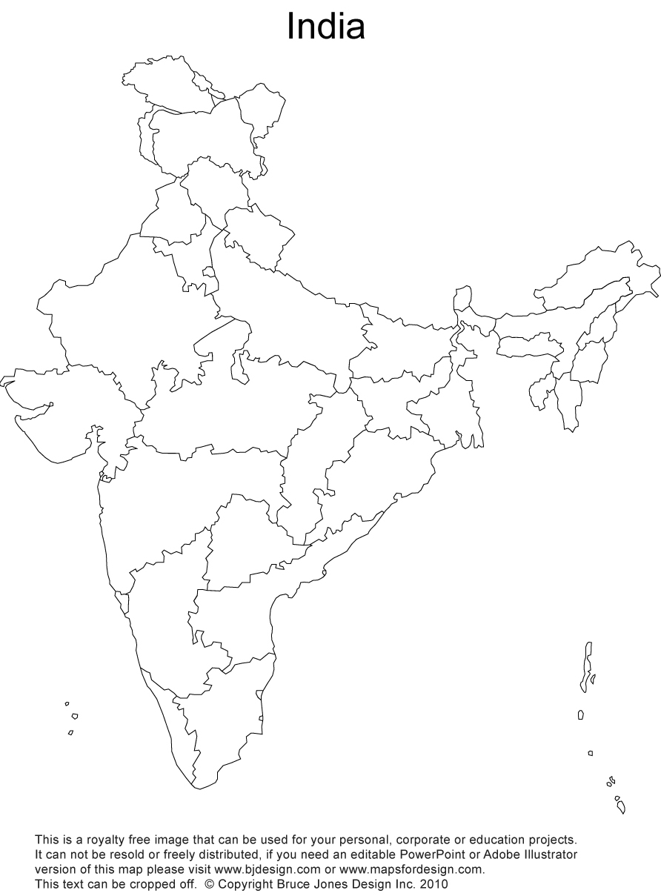




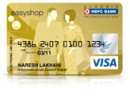

Bringing Customer Closer
Delhi
1 Day
10-12
Days
Mumbai
Aurangabad
Chennai
INSTA DEBIT CARD

Slide 30
FTNR Reduction: Form Simplification &
Upfront Scrutiny
Level 1: Fast Moving
Level 2 : Slow Moving
Two Level Welcome Desk
Form Simplification: Annotation reduced by 70% and data fields reduced by 30%
Notes:
30

Slide 31


Enabling Reissuance of Hotlisted Card: Phonebanking
YES
Part 1 - PLACING THE REQUEST
Customer asked for Telephone Identification Number(TIN)
Alternate authentication
Reissuance request permitted at a later day.
Key Changes
NO
TIN available with customer?
YES
Customer request taken & forwarded to Ops.

Slide 32
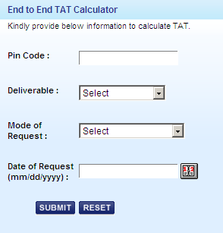
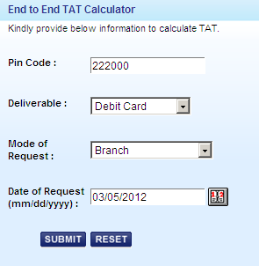

Accurate and Uniform TAT Commitment
End to End TAT re-defined for non Insta Debit Cards
Web based Utility was made available to Front Channels. Utility ensures: -
Gives Pin code wise TAT
Ensures uniform Communication

Slide 33

Insta PIN – “Green PIN”
Request PIN
OTP Sent thru sms
PIN Generated @ ATM using OTP
Paperless
Instant
Secure
Green Pin UAT testing is completed. Results successful
Go Live by Oct 12

Slide 34
Results

Slide 35
Achievement & Sustenance
Project Phase
Project Phase

Slide 37
Control Plan
S. No. | Activity | Frequency | Responsibility
1 | Branch wise Insta Debit Card Penetration MIS | Daily | Product
2 | End to end TAT Dashboard (Non Insta Cards) | Monthly | Audit
3 | Mystery Shopping at Branches and Phone Banking | Monthly | QIG
4 | Complaints MIS – Trend Analysis | Monthly | QIG
5 | Voice of Customers thru external source | Quarterly | QIG
6 | TAT Utility Master Updation | Monthly | Operations
7 | Track Redirection requests | Daily | Operations

Slide 38


Benefits
Net benefit = 6.41 crores / Annum
Total Investment
0.02
6.43
1.2
2.23
1.83
0.02
1.17
Cost Saving
Insta cards: Rework, Courier and Return Cards Handling, Form Processing costs
Reissuance thru Phone:
Rework, Form Processing cost.
Development cost of TAT Calculator
Old Card Deactivation:
Complaint handing
TAT Communication: Complaint handing
Debit Card portfolio spends is growing by 30%
* All figures in crores

Slide 39
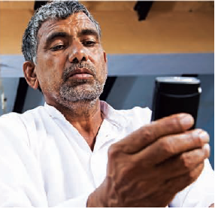
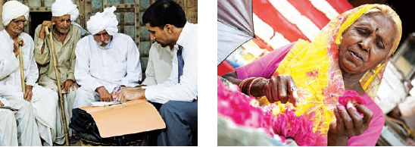
Rural Penetration So far….
We provide banking to 1.5 millions customers across 232 rural locations.
Heading towards our resolve to provide sustainable livelihood to 7 millions customers in next 5 years.

Slide 40
Horizontal Deployment & Way Forward
Success of this project inspired us to launch much larger strategic project “INSTA_GRATIFICATION” which encompasses:
Insta account activation
Instant FD/RD Booking @ Branches
Investment Services Account activation
Credit Card Upgradation

Slide 41
Thank You!

